Slide 1




USING LIDAR TO ASSESS THE ROLES OF CLIMATE AND LAND-COVER DYNAMICS AS DRIVERS OF CHANGES IN BIODIVERSITY
PIs: Giorgos Mountrakis, Colin Beier, Bill Porter⁺, Benjamin Zuckerberg^, Lianjun Zhang, Bryan Blair*
PhDs: Huiran Jin, Wei Zhuang, John Wiley, Marta Jarzyna
SUNY College of Environmental Science & Forestry
⁺Michigan State University
^University of Wisconsin
*NASA Goddard Space Flight Center

Slide 2
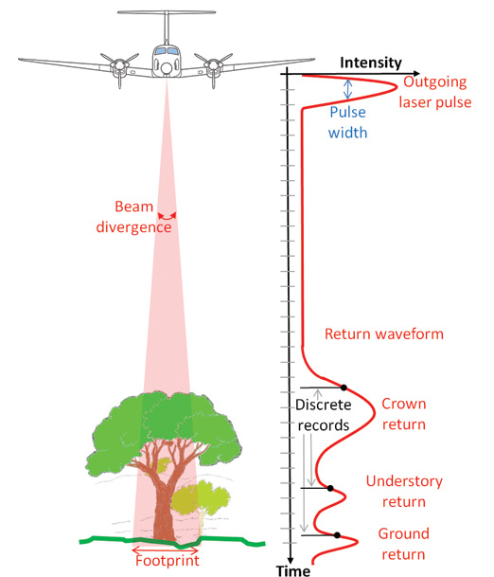
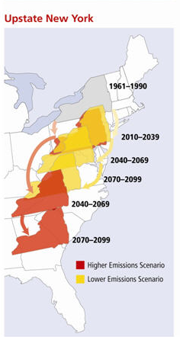
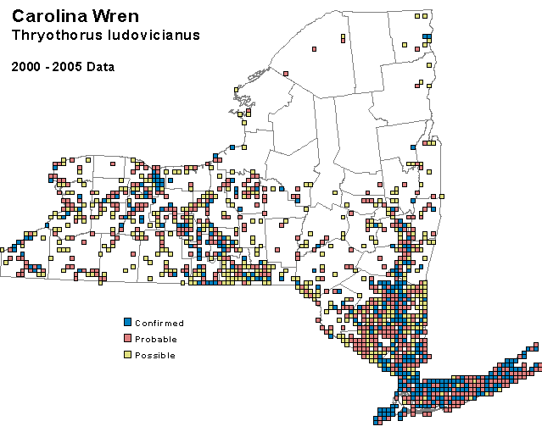

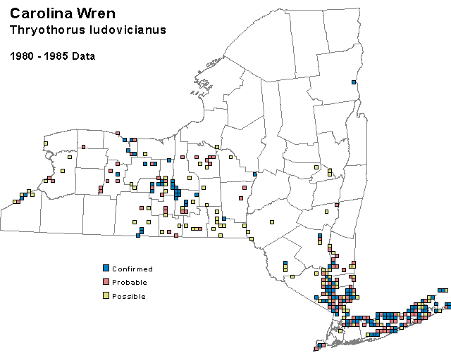
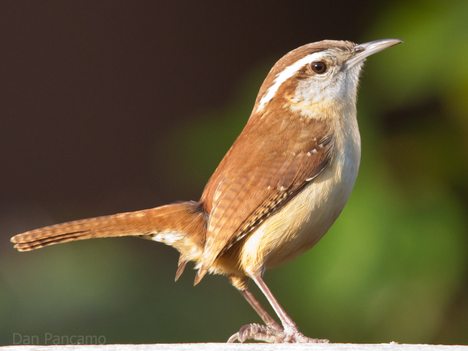
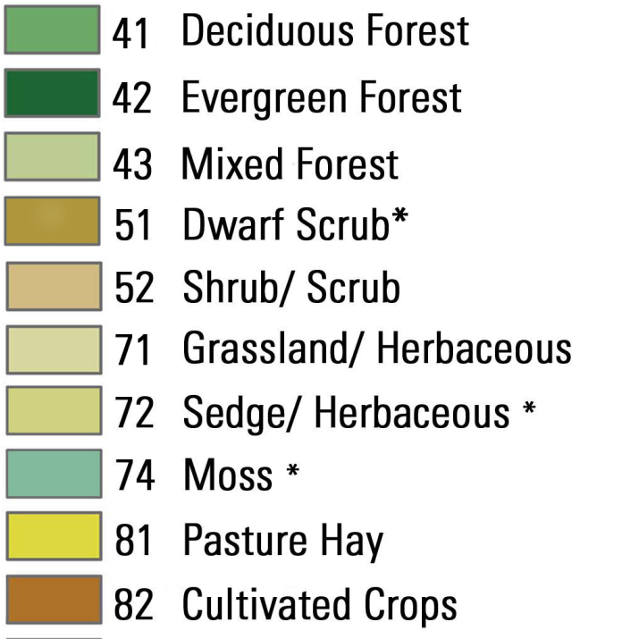
Introduction

Slide 3
Research Questions:
  Does the addition of waveform LiDAR data improve the ability of multispectral image processing to classify habitat types?
  Can a model of successional dynamics coupled with LiDAR-derived vegetation structure information help predict past and future habitat trends?
  To what degree do climate changes and habitat trends affect breeding bird range shifts, and can we effective model future bird dynamics?

Slide 4
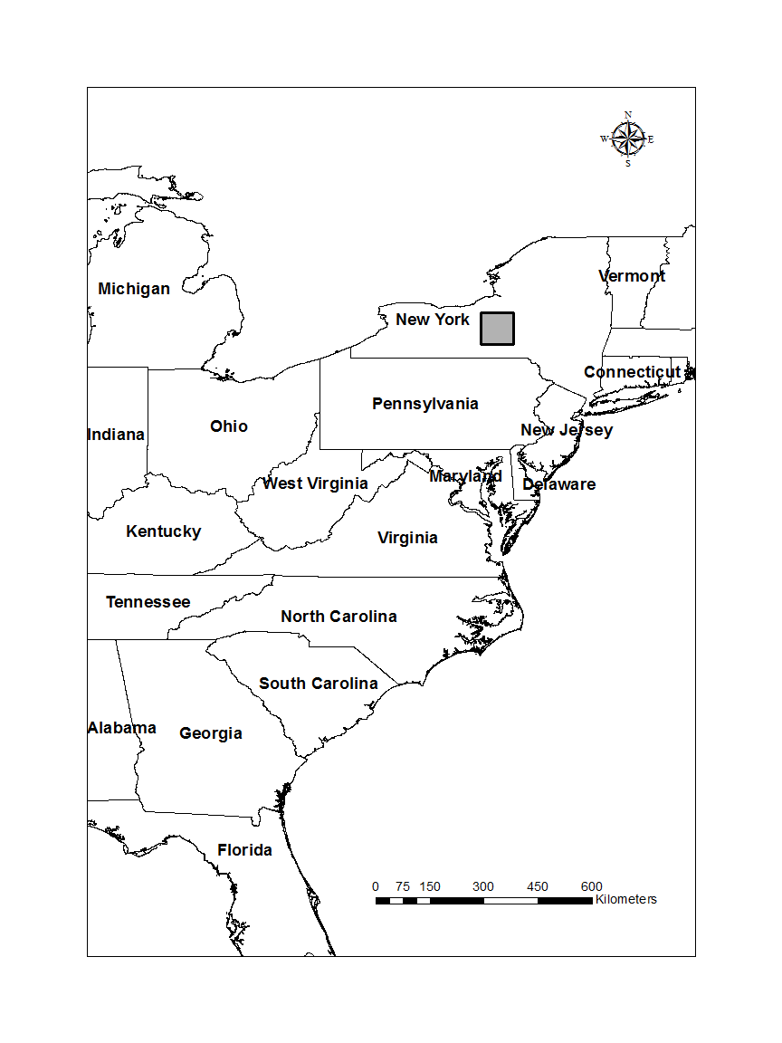
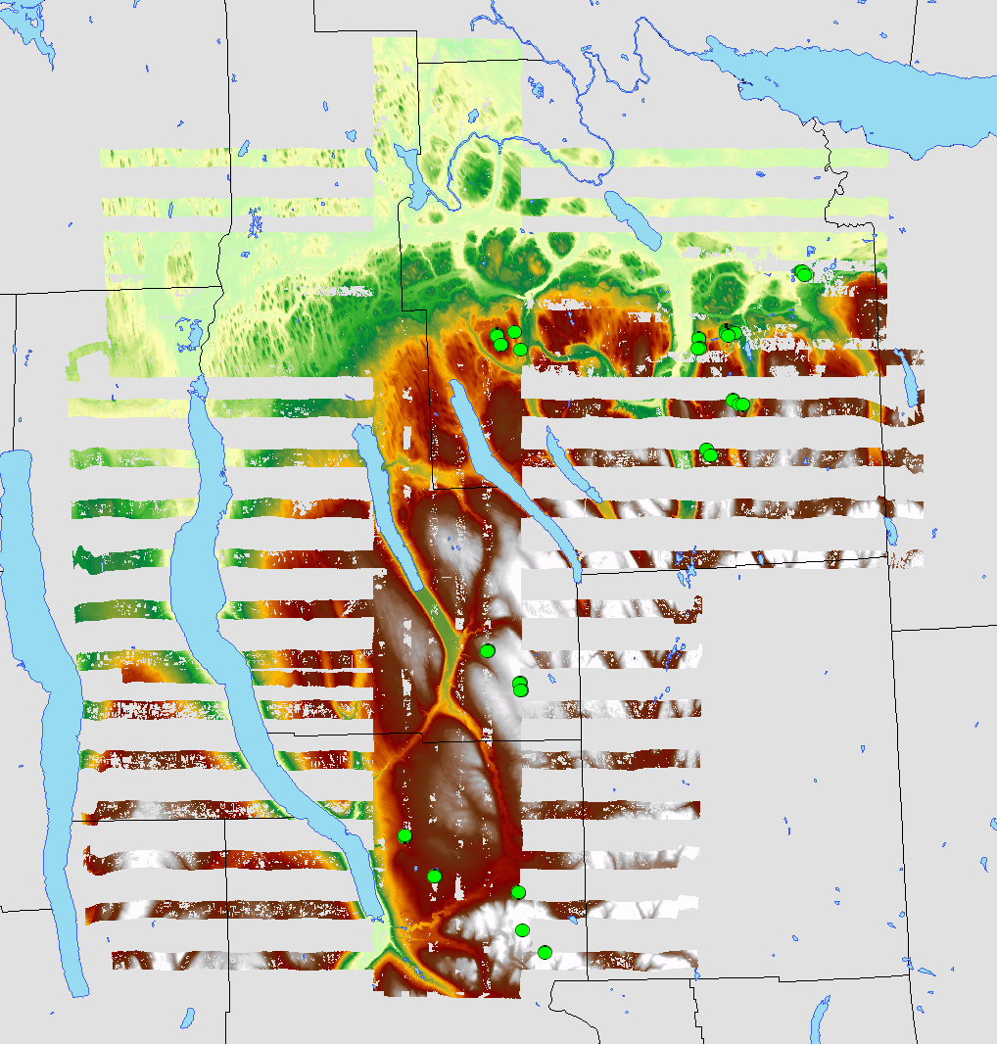
Study Area: Central New York

Slide 5
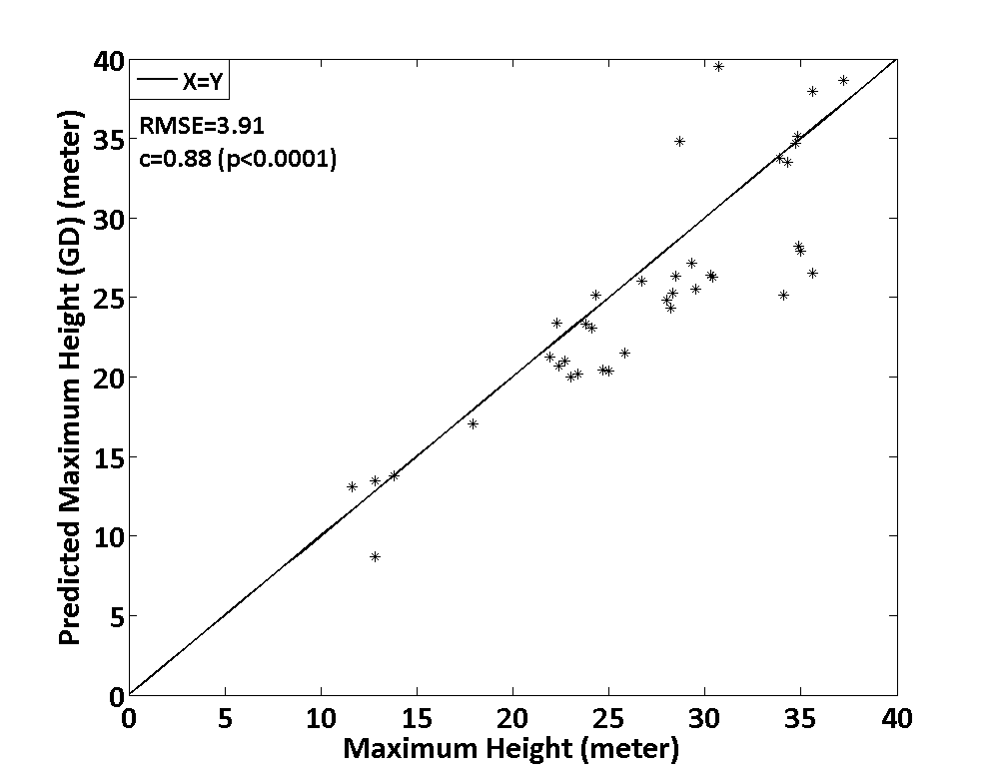
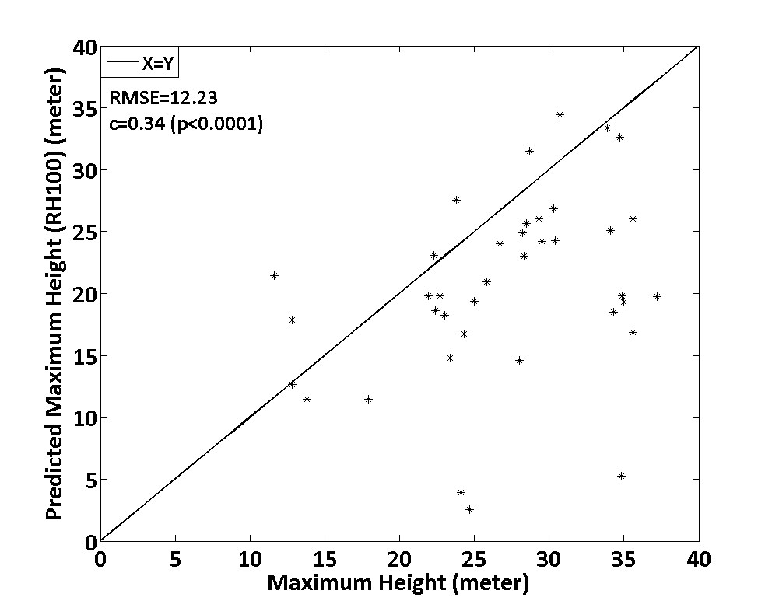
Results: LiDAR Improved treetop height estimation
Proposed method
Existing method
Treetop Height VS. Gaussian Decomposition
Treetop Height VS. RH100 values

Slide 6
Results: LiDAR improved biomass estimation
Proposed method:
Adjusted R² = 0.7-0.8
If you have Biomass Data over LVIS signals please contact us:
Giorgos Mountrakis - gm@esf.edu
Existing methods
Adjusted R² = 0.5-0.65

Slide 7
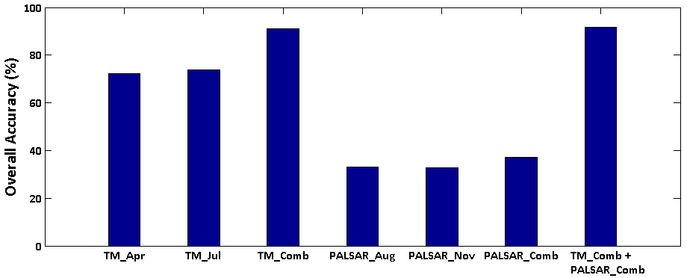
Results: Integration of Landsat, PALSAR, and LVIS
Multi-temporal Landsat offers significant benefits in OVERALL classification accuracy
90.95
91.73
72.27
73.90
37.09
33.09
32.74

Slide 8
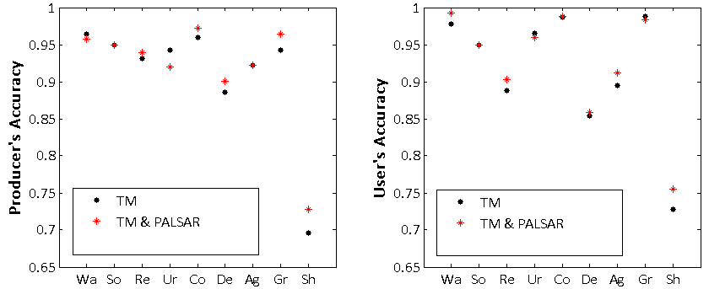
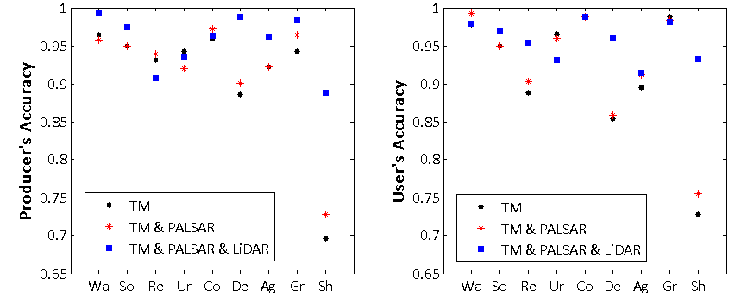
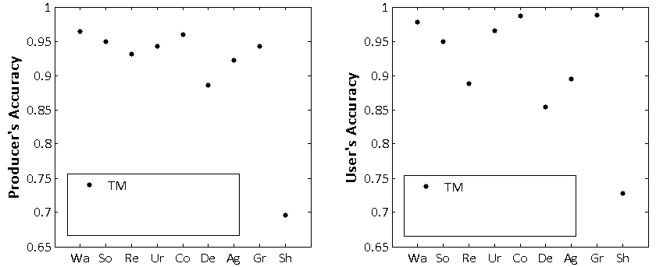
Results: Integration of Landsat, PALSAR, and LVIS

Slide 9
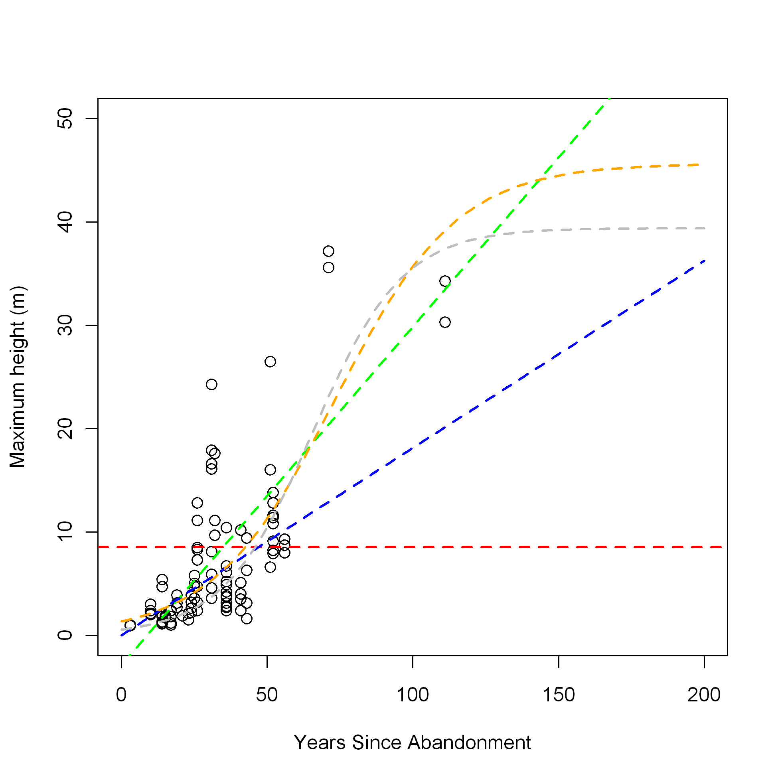
Results: Succession modeling

Slide 10
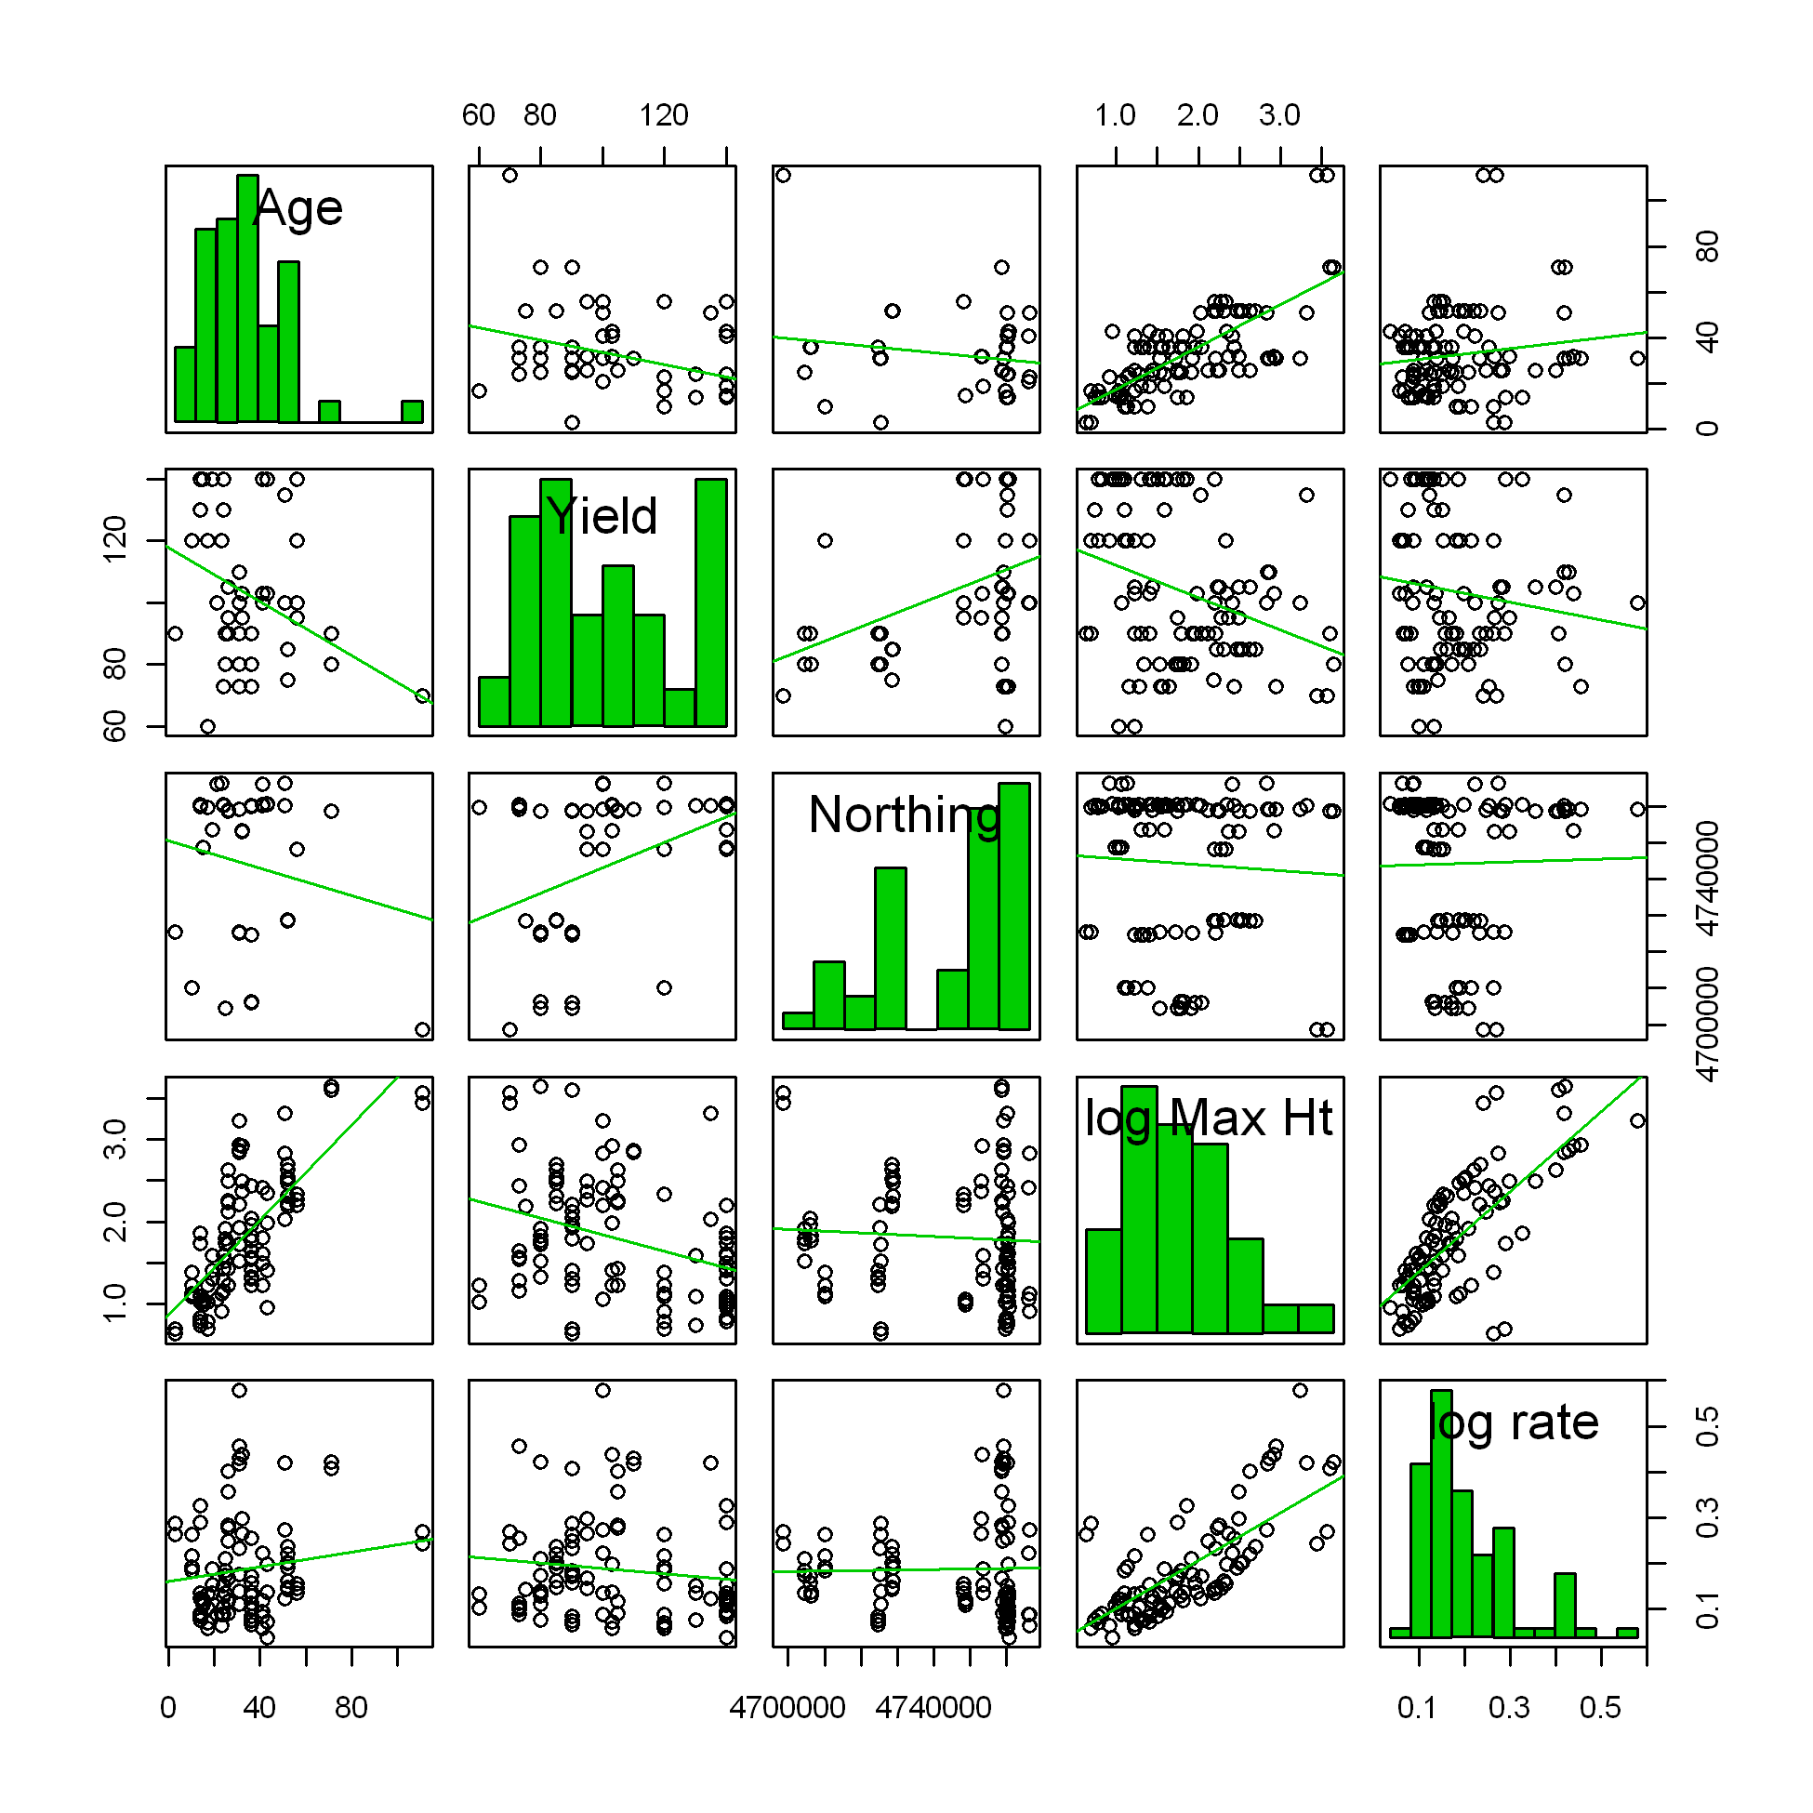
Results: Succession modeling

Slide 11
Results: Climate change mapping
Recent trends in NY and US Northeast mapped at 4km resolution (1980-2009)
Based on PRISM (Daly et al. 2002) and NRCC (DeGaetano & Belcher 2007)
Theil-Sen and linear estimations
Seasonal and spatial variability in recent temperature changes
Tmin warming at greater rate and more seasonally consistent
Tmax trends variable by month
Trend maps are heterogeneous, with patches of warming, stability and cooling

Slide 12
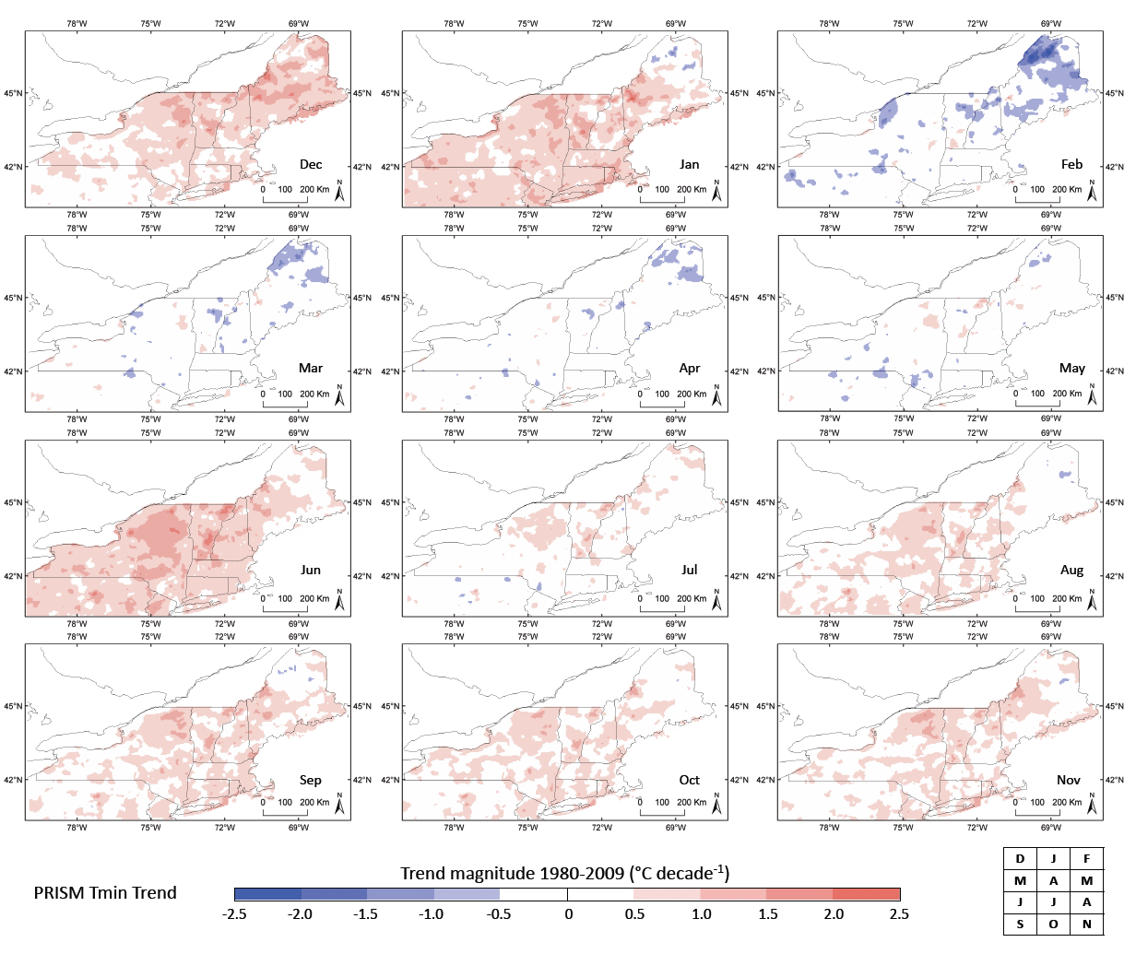
Beier et al. 2011 Landscape Ecol.

Slide 13
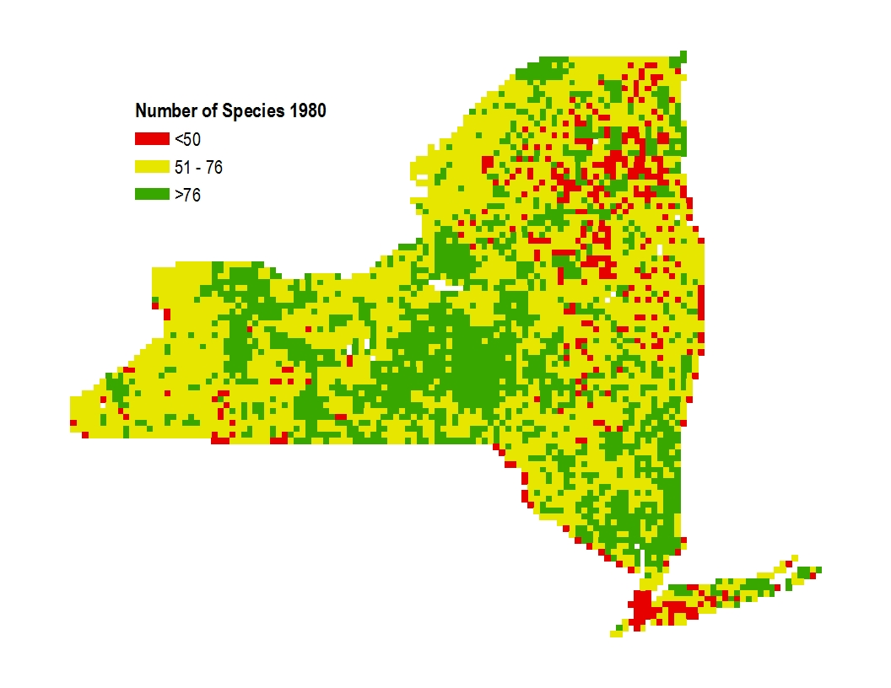
Results: Breeding bird biodiversity
Species Richness in 1980 – Preliminary Results
Notes:
Map of alpha diversity – number of species per block at the time of the first atlas period (1980-85)

Slide 14
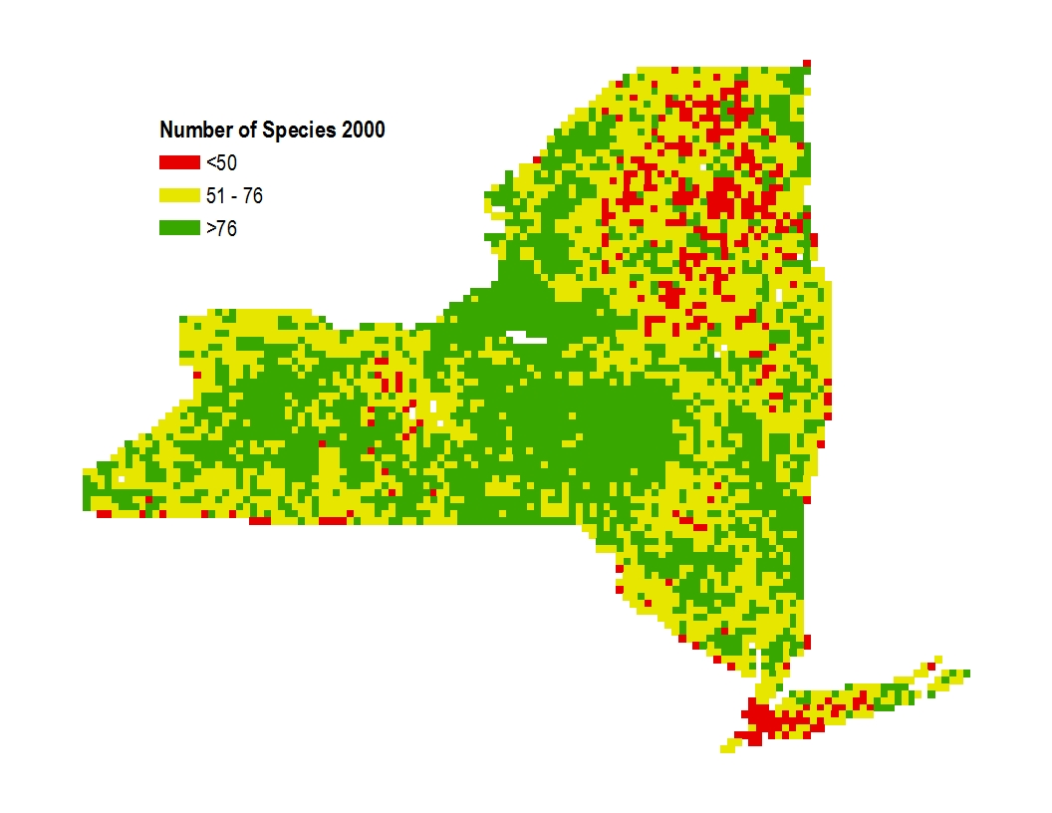
Results: Breeding bird biodiversity
Species Richness in 2000 – Preliminary Results
12% increase in number of blocks w/ >76 species:
34% in 1980
46% in 2000
Notes:
Preliminary data analysis indicates that there has been a 12% increase in the number of blocks that had more than 76 species. This indicates that in many locations we have observed communities being invaded.

Slide 15
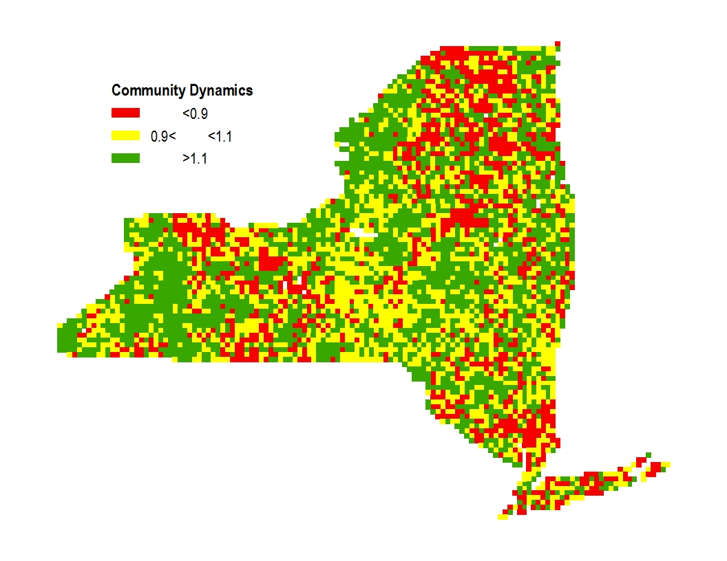
Results: Breeding bird biodiversity
Community Dynamics 1980 – 2000 – Preliminary Results
Communities w/ increasing number of species: 43%
Communities w/ decreasing number of species: 34%
Communities w/ constant number of species: 23%
λ_{s}
λ_{s}
λ_{s}
Notes:
Our preliminary results indicate also that approximately 43% of all blocks have lambda >1.1 - these are the communities that are being invaded. 34% of blocks have communities that have lost species between 1980 and 2000. In approximately 23% of all blocks the number of species between the two time periods remained constant.

Slide 16
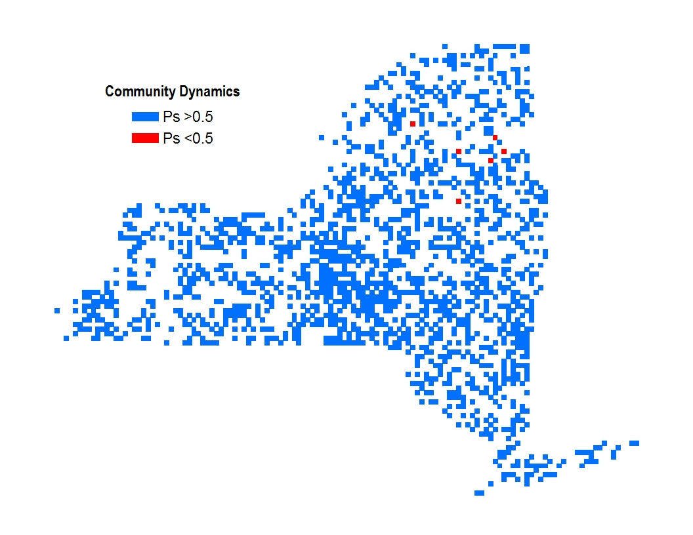
Results: Breeding bird biodiversity
Community Dynamics 1980 – 2000 – Preliminary Results
Communities stationary: >99%
Communities not stationary: <1%
Notes:
Of those communities, where the number of species remained constant, almost all are communities with high persistence rates (stationary communities).

Slide 17
Summary
  Land cover classifier -> shrubs
  Climate trends (Beier et al. 2012)
  LiDAR calibration -> automate
  Successional model
  Drivers of breeding bird shifts

Slide 18
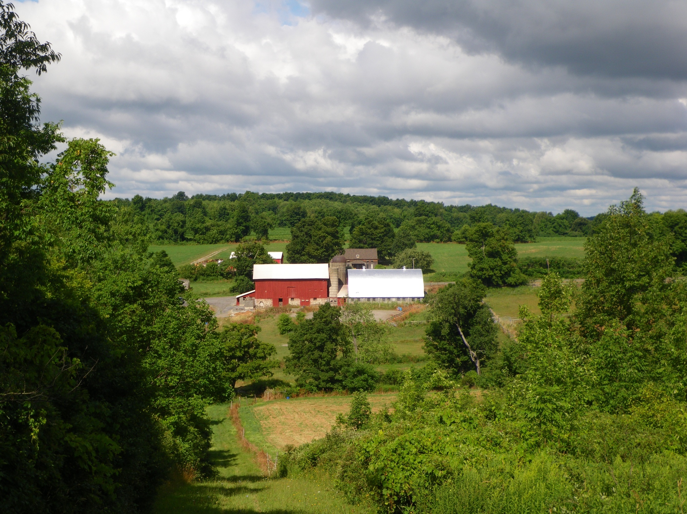
Questions?

